Slide 1
UG PROJECT : E-Writer using Microcontroller
NAME: DEPANI BHUMIL RAJNIKANTBHAI
ADMISSION NO.: U16EC076
GUIDE: Dr. A. D. DARJI (ASSOCIATE PROFESSOR & HEAD, ECED)
CO-GUIDE: Dr. J. N. Sarvaiya (ASSOCIATE PROFESSOR, ECED)

Slide 2
What’s the problem?
Paper wastage
Cumbersome to maintain individual copy for every subject
Deforestation
Global Warming
High Water Usage

Slide 3
Objective of this Project
To make Low Cost device that can replace traditional way of writing
Reduce Paper usage and side effects created by production of papers
Facilitate with extra feature to the user which are not in the traditional notebook
No need of android framework

Slide 4

Outline of the Project

Slide 5
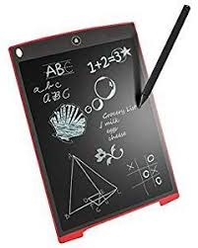
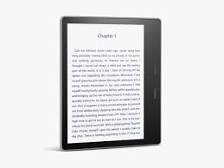
Product Survey
Amazon Kindle, used for only reading purpose
Memory less E-writer
price hunt, https://www.price-hunt.com/tablets/rewy-15-r-8-5-inch-e-writer-lcd-writing-pad-paperless-memo-digital-tablet-notepad-stylus-drawing-for-erase-button-and-pen-to-write.php
Good Reader, https://goodereader.com/blog/electronic-readers/amazon-kindle-paperwhite-4-review

Slide 6
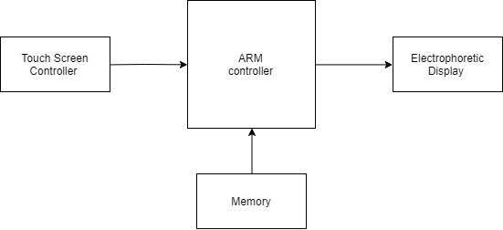
Hardware Requirement

Slide 7
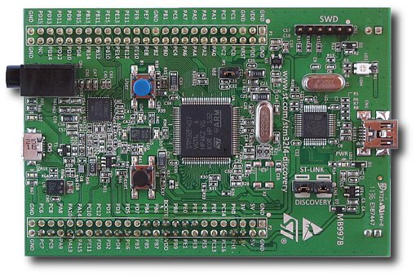
Processing Unit
STM32F407VGT6 Microcontroller
STM32F4 Discovery Kit
ST-Link Programmer and Debugger
ST Microelectronics, “Discovery kit with STM32F407VG MCU”, Datasheet UM1472, Sep. 2011 [Revised May. 2017].

Slide 8
Memory Organization
ROM
RAM
Data Storage (EEPROM)

Slide 9
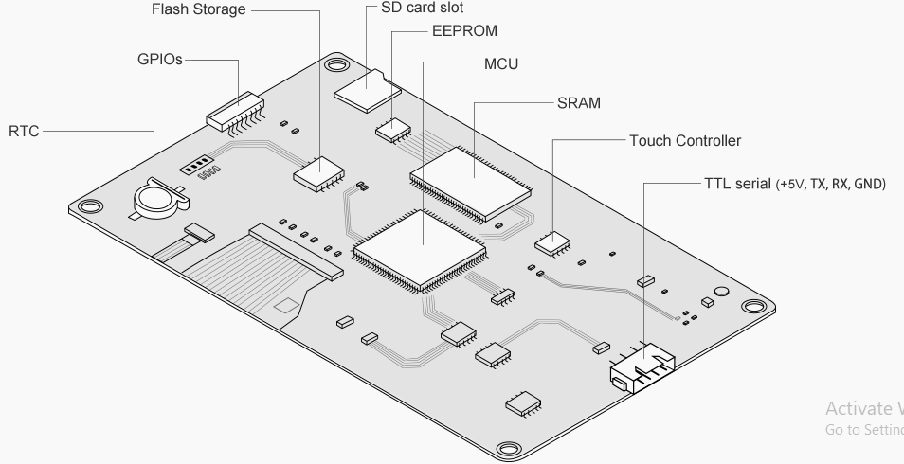
LCD Module
Nextion Technology, “NX8048K070”, Datasheet, May. 2011[Revised Oct. 2018].

Slide 10
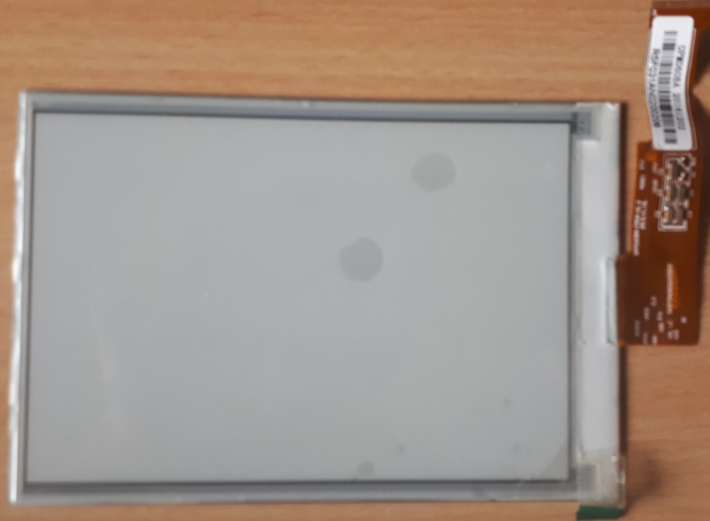
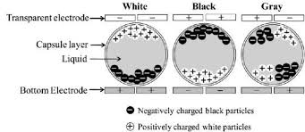
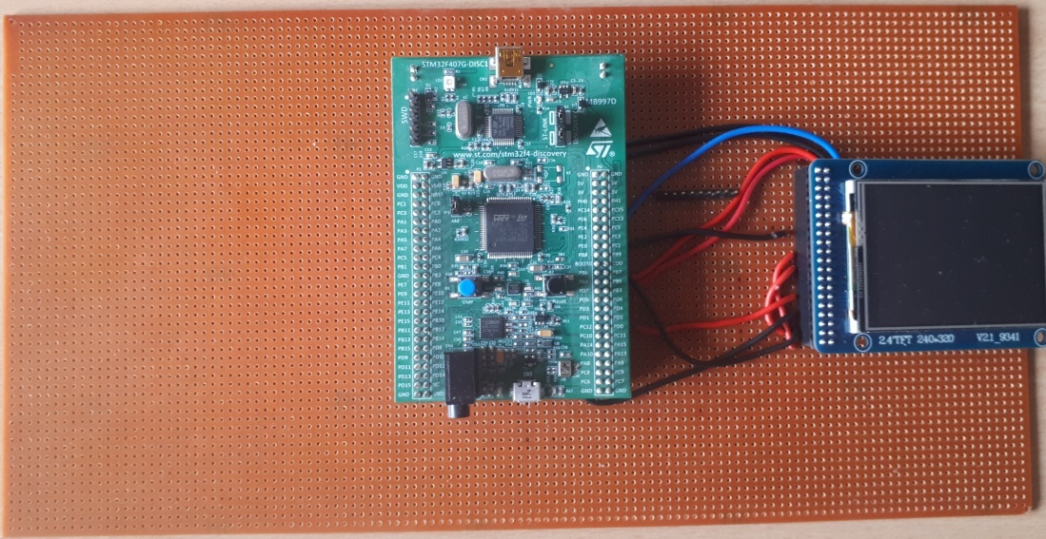
Display Module

Slide 11
Firmware
Options for Tool chain
IAR Embedded Workbench
Microcontroller Development Kit for ARM (MDK-ARM) by Keil
TrueSTUDIO® by Atollic
TASKING VX-toolset for ARM Cortex by Altium
YAGARTO the open-source GNU ARM toolchain

Slide 12
Firmware
Options for Coding
Using only MDK-Keil
Framework using STM32CubeMX software and MDK-Keil

Slide 13
Firmware
Software Configuration and Structure

Slide 14
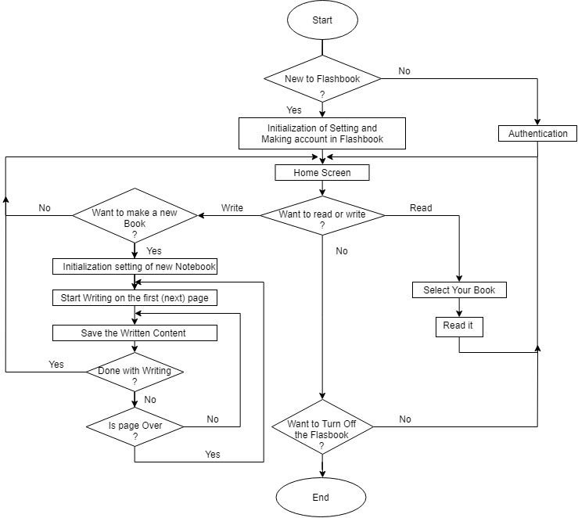
Logical View of Software flow

Slide 15
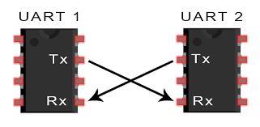
LCD INTERFACING
Making GUI using ‘Nextion Editor’
UART Communication Link
Circuit Basics, http://www.circuitbasics.com/basics-uart-communication/

Slide 16
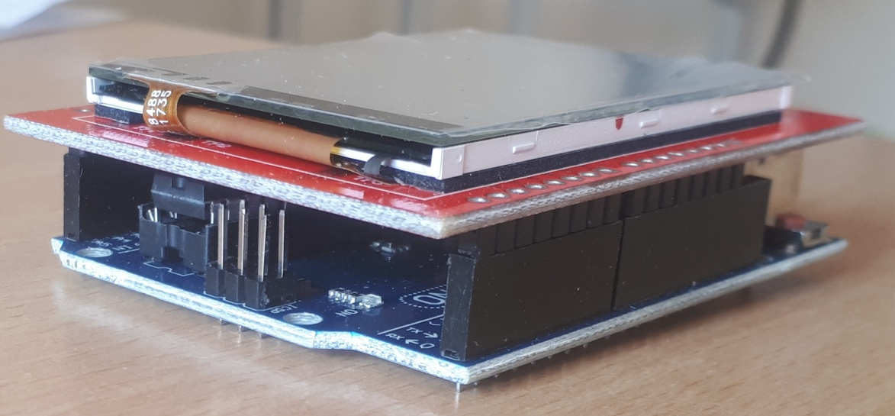
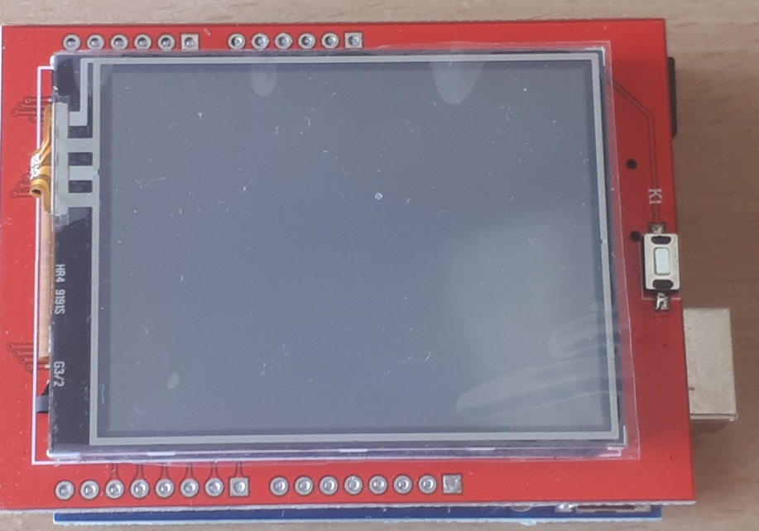
Display Module with Arduino

Slide 17
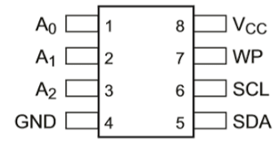
Data Storage
Storage of data in offline mode using EEPROM
Storage of data on cloud (using ESP8266)

Slide 18
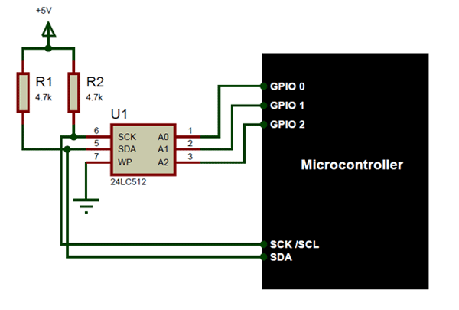
Memory Interfacing
Components101,https://components101.com/ics/24lc512-eeprom-pinout-equivalent-datasheet (accessed Mar. 30th, 2020)

Slide 19
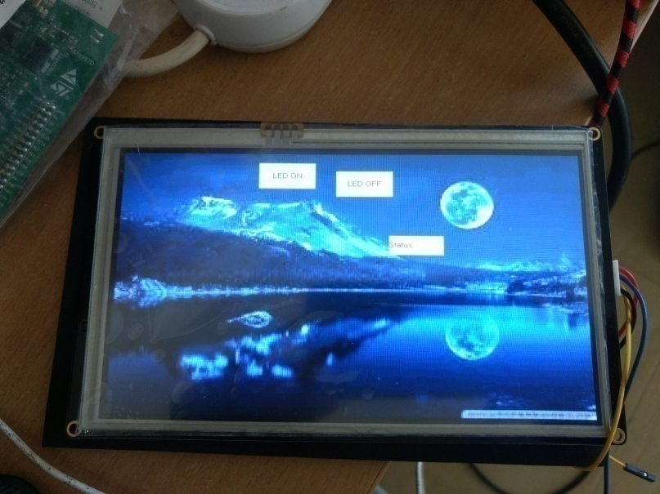
RESULTS
Graphical User Interface made using Nextion Editor:

Slide 20
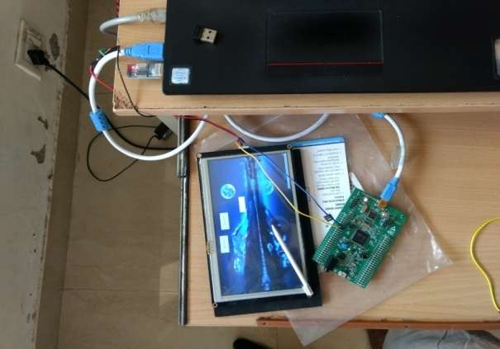
RESULTS
Interfacing between STM microcontroller and LCD:

Slide 21
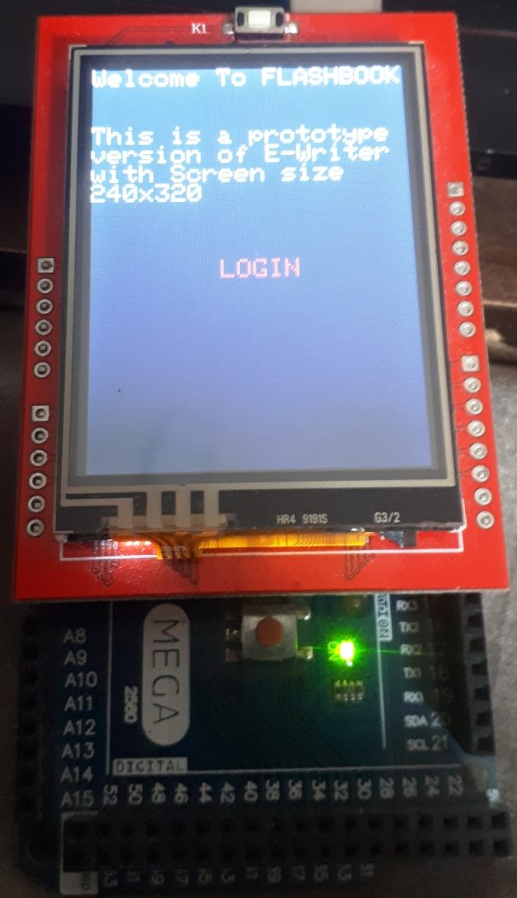
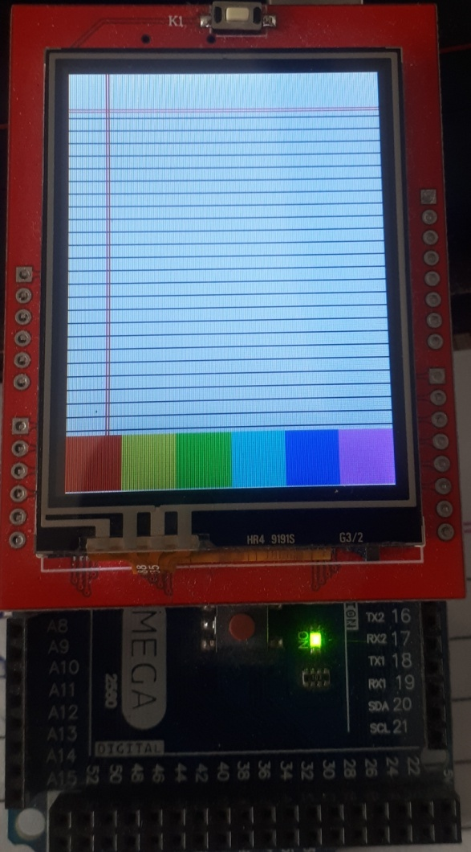
RESULTS

Slide 22
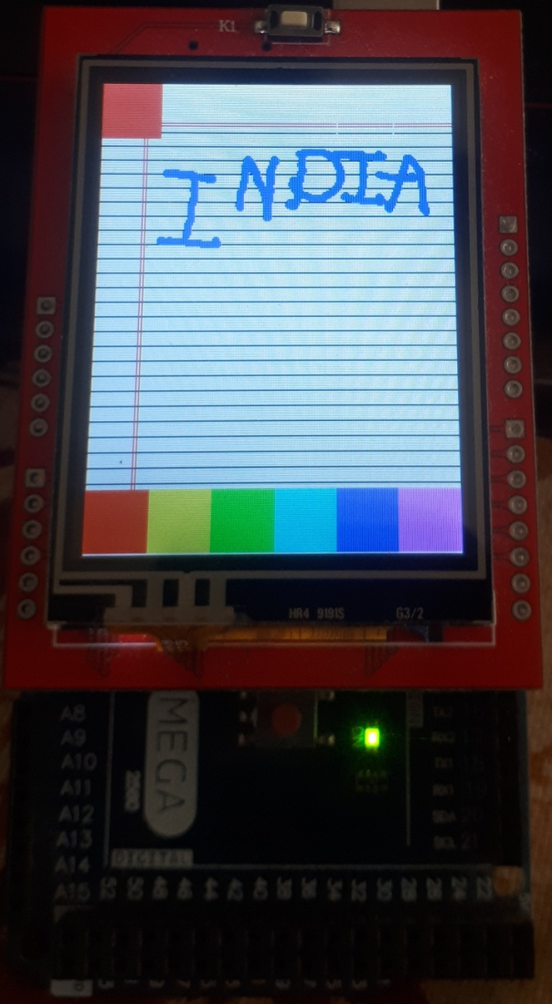
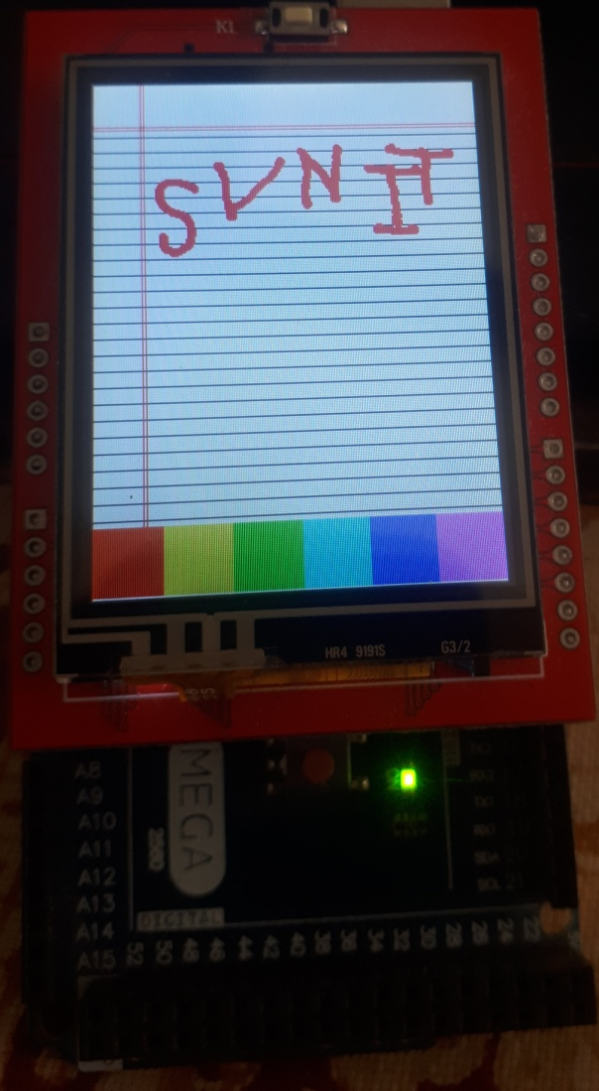
RESULTS
Text written on the E-Writer

Slide 23
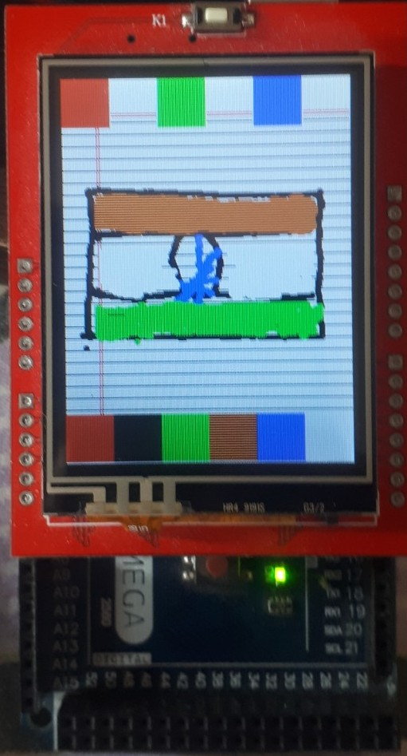
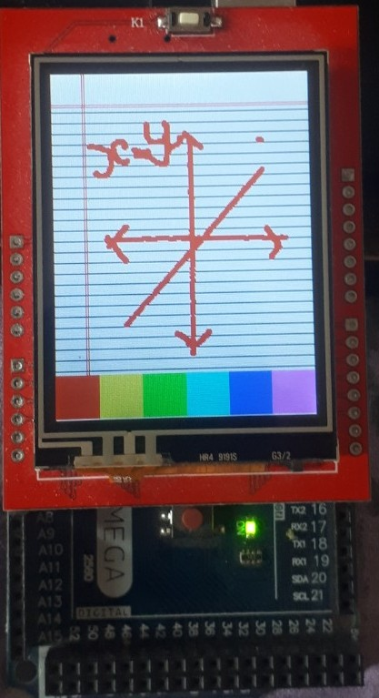
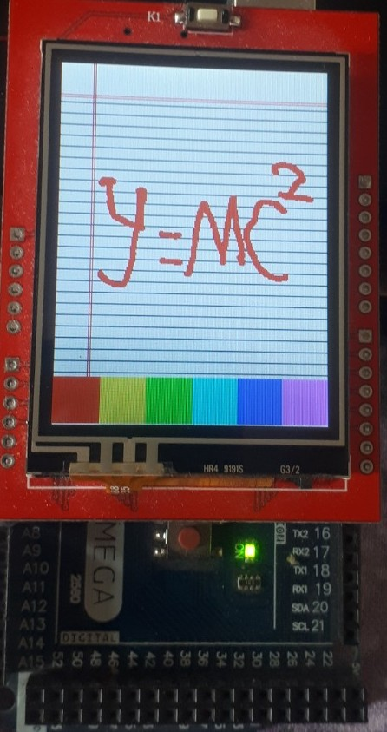
RESULTS
Figure, equation and graph on the E-writer

Slide 24
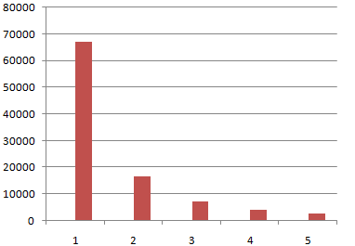
Analysis
Latency of Display updation: 500 milliseconds
6 hours of battery backup
Graph between required memory and text size

Slide 25
Optimization Possible
To add easy going User-interface
To add more functionality for cloud storage

Slide 26
CONCLUSION
Affordable microcontroller based E-writer
Efficient data storage

Slide 27
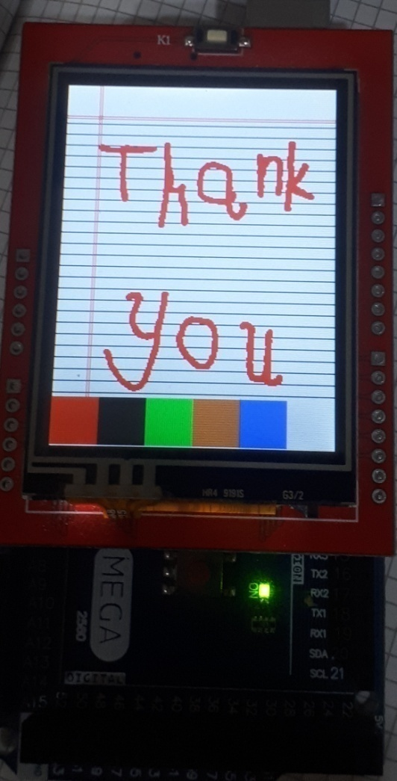
Any
Questions?

